Slide 1
CS 551
Spring 2025

Slide 2
Boring!
Nothing super new and exciting yet
Cargo is cool, type inference is cool, etc.
Still nothing that is super exciting compared to C
Not true exactly!
Let’s talk about pattern matching!

Slide 3
Pattern Matching
Pattern matching is a way to test for types
It is super powerful
Relatively common in functional languages
Being grafted on to other languages as well
They allow for really cool stuff like destructuring data types
We’ll talk more later!

Slide 5
We’re going to use the Ordering enum from standard library

Slide 6
We’re going to be doing pattern matching

Slide 7
We’re going to be doing pattern matching
To figure out if our guess is >, <, or = our secret_number

Slide 8
cmp is going to return an Ordering type, which is an enum with three variants

Slide 9
Each variant is a type as well! (kinda, but not really, see https://internals.rust-lang.org/t/prerfc-enum-variant-types/18984 for more info)

Slide 10
The match expression contains various arms

Slide 11
The left hand side of an arm (to the left of =>) is called the pattern

Slide 12
The code that will run if the pattern matches is on the right side of the =>

Slide 13
If the variant of the return value from cmp() is Ordering::Greater
Then println!(“You guessed too high!”)

Slide 14
If the variant of the return value from cmp() is Ordering::Less
Then println!(“You guessed too low!”)

Slide 15
If the variant of the return value from cmp() is Ordering::Equal
Then println!(“You got it right!”)

Slide 16
Note that these are commas, not semi-colons.
That is because what is on the right of the => is an expression not a statement

Slide 17
Note that you can have bigger blocks of code that can be run if a pattern matches, not just a single line

Slide 18
What might this do?

Slide 19
Variables
let statement
Binds a value to a variable
If you want to change that value, your variable must be declared mut

Slide 20
Variables
let statement
Binds a value to a variable
If you want to change that value, your variable must be declared mut

Slide 21
Variables
let statement
Binds a value to a variable
If you want to change that value, your variable must be declared mut
Will this compile?

Slide 22
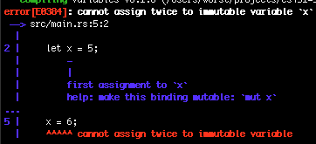

Slide 23
Variables
let statement
Binds a value to a variable
If you want to change that value, your variable must be declared mut
Compiler will enforce this!
You can shadow a previous variable by using another let statement

Slide 24
Variables
let statement
Binds a value to a variable
If you want to change that value, your variable must be declared mut
Compiler will enforce this!
You can shadow a previous variable by using another let statement

Slide 25
Variables
let statement
Binds a value to a variable
If you want to change that value, your variable must be declared mut
Compiler will enforce this!
You can shadow a previous variable by using another let statement
You can change types when you shadow other variables

Slide 26
Variables
let statement
Binds a value to a variable
If you want to change that value, your variable must be declared mut
Compiler will enforce this!
You can shadow a previous variable by using another let statement
You can change types when you shadow other variables

Slide 27
Variables
let statement
Binds a value to a variable
If you want to change that value, your variable must be declared mut
Compiler will enforce this!
You can shadow a previous variable by using another let statement
You can change types when you shadow other variables
Types cannot be changed via a mutation though!

Slide 28
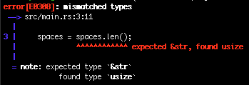
Variables
let statement
Binds a value to a variable
If you want to change that value, your variable must be declared mut
Compiler will enforce this!
You can shadow a previous variable by using another let statement
You can change types when you shadow other variables
Types cannot be changed via a mutation though!

Slide 29
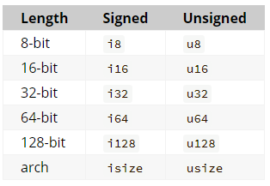
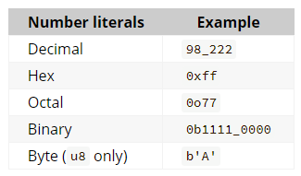
Primitive Types
Also floating points: f32 and f64 (32 bit and 64 bit)

Slide 30
Constants
Constants are not just immutable variables
You can’t have a mut constant at all
Can be declared in any scope (including global)
Constants can only be assigned the value of a constant expression
They can’t be the result of a function or anything that is computed at runtime

Slide 31
Constants
Constants are not just immutable variables
You can’t have a mut constant at all
Can be declared in any scope (including global)
Constants can only be assigned the value of a constant expression
They can’t be the result of a function or anything that is computed at runtime

Slide 32
Constants
const keyword
Constants are not just immutable variables
You can’t have a mut constant at all
Can be declared in any scope (including global)
Constants can only be assigned the value of a constant expression
They can’t be the result of a function or anything that is computed at runtime

Slide 33
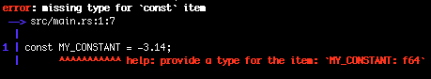
Constants
Constants are not just immutable variables
You can’t have a mut constant at all
Can be declared in any scope (including global)
Constants can only be assigned the value of a constant expression
They can’t be the result of a function or anything that is computed at runtime

Slide 34
Constants
Constants are not just immutable variables
You can’t have a mut constant at all
Can be declared in any scope (including global)
Constants can only be assigned the value of a constant expression
They can’t be the result of a function or anything that is computed at runtime
Compiler demands a type for const

Slide 35
Constants
Constants are not just immutable variables
You can’t have a mut constant at all
Can be declared in any scope (including global)
Constants can only be assigned the value of a constant expression
They can’t be the result of a function or anything that is computed at runtime
Compiler also gives us a hint as to what that type should maybe be

Slide 36
Constants
Super important: pay attention to compiler errors!
For the most part they are quite informative
Constants are not just immutable variables
You can’t have a mut constant at all
Can be declared in any scope (including global)
Constants can only be assigned the value of a constant expression
They can’t be the result of a function or anything that is computed at runtime

Slide 37
Constants
We annotate the type and are good!
Constants are not just immutable variables
You can’t have a mut constant at all
Can be declared in any scope (including global)
Constants can only be assigned the value of a constant expression
They can’t be the result of a function or anything that is computed at runtime

Slide 38
Functions
Functions are something that (may) take parameters and evaluate to something
Functions defined via fn keyword
Function parameter types must be specified
Function return types must be specified
The return value of a function is the last expression executed before the function goes out of scope

Slide 39
Functions
Functions are something that (may) take parameters and evaluate to something
Functions defined via fn keyword
Function parameter types must be specified
Function return types must be specified
The return value of a function is the last expression executed before the function goes out of scope

Slide 40
Functions
Does it compile?
Functions are something that (may) take parameters and evaluate to something
Functions defined via fn keyword
Function parameter types must be specified
Function return types must be specified
The return value of a function is the last expression executed before the function goes out of scope

Slide 41
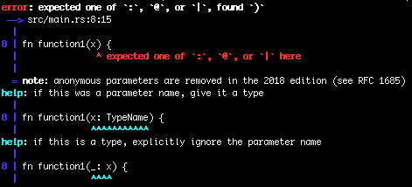
Functions
Functions are something that (may) take parameters and evaluate to something
Functions defined via fn keyword
Function parameter types must be specified
Function return types must be specified
The return value of a function is the last expression executed before the function goes out of scope

Slide 42
Functions
Functions are something that (may) take parameters and evaluate to something
Functions defined via fn keyword
Function parameter types must be specified
Function return types must be specified
The return value of a function is the last expression executed before the function goes out of scope

Slide 43
Functions
We annotate the type and are good!
Functions are something that (may) take parameters and evaluate to something
Functions defined via fn keyword
Function parameter types must be specified
Function return types must be specified
The return value of a function is the last expression executed before the function goes out of scope

Slide 44
Functions
Functions are something that (may) take parameters and evaluate to something
Functions defined via fn keyword
Function parameter types must be specified
Function return types must be specified
The return value of a function is the last expression executed before the function goes out of scope

Slide 45
Functions
Functions are something that (may) take parameters and evaluate to something
Functions defined via fn keyword
Function parameter types must be specified
Function return types must be specified
The return value of a function is the last expression executed before the function goes out of scope

Slide 46
Functions
Return type specified with
“-> Type”
Functions are something that (may) take parameters and evaluate to something
Functions defined via fn keyword
Function parameter types must be specified
Function return types must be specified
The return value of a function is the last expression executed before the function goes out of scope

Slide 47
Functions
Functions are something that (may) take parameters and evaluate to something
Functions defined via fn keyword
Function parameter types must be specified
Function return types must be specified
The return value of a function is the last expression executed before the function goes out of scope

Slide 48
Functions
Does it compile?
Functions are something that (may) take parameters and evaluate to something
Functions defined via fn keyword
Function parameter types must be specified
Function return types must be specified
The return value of a function is the last expression executed before the function goes out of scope

Slide 49
Functions
Does it compile?
Functions are something that (may) take parameters and evaluate to something
Functions defined via fn keyword
Function parameter types must be specified
Function return types must be specified
The return value of a function is the last expression executed before the function goes out of scope
Note the semicolon…

Slide 50
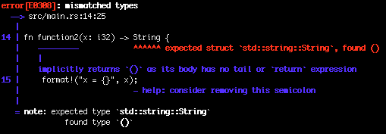
Functions
Functions are something that (may) take parameters and evaluate to something
Functions defined via fn keyword
Function parameter types must be specified
Function return types must be specified
The return value of a function is the last expression executed before the function goes out of scope

Slide 51
Functions
We just added a semi colon, what the heck?
Functions are something that (may) take parameters and evaluate to something
Functions defined via fn keyword
Function parameter types must be specified
Function return types must be specified
The return value of a function is the last expression executed before the function goes out of scope

Slide 52
Functions
Functions are something that (may) take parameters and evaluate to something
Functions defined via fn keyword
Function parameter types must be specified
Function return types must be specified
The return value of a function is the last expression executed before the function goes out of scope

Slide 53
Functions
Functions are something that (may) take parameters and evaluate to something
Functions defined via fn keyword
Function parameter types must be specified
Function return types must be specified
The return value of a function is the last expression executed before the function goes out of scope
We can use a return statement too

Slide 54
Functions
Functions are something that (may) take parameters and evaluate to something
Functions defined via fn keyword
Function parameter types must be specified
Function return types must be specified
The return value of a function is the last expression executed before the function goes out of scope
We can use a return statement too

Slide 55
Control flow
This is how you ensure code runs under certain conditions
if, else if, else
Just like any other language
Remember that whatever you are conditioning on must result in a bool
If statements are expressions
This means they can be used within a let statement!

Slide 56
Control flow
This is how you ensure code runs under certain conditions
if, else if, else
Just like any other language
Remember that whatever you are conditioning on must result in a bool
If statements are expressions
This means they can be used within a let statement!

Slide 57
Control flow
This is how you ensure code runs under certain conditions
if, else if, else
Just like any other language
Remember that whatever you are conditioning on must result in a bool
If statements are expressions
This means they can be used within a let statement!
Note trailing ;
let is a statement

Slide 58
Control flow
This is how you ensure code runs under certain conditions
if, else if, else
Just like any other language
Remember that whatever you are conditioning on must result in a bool
If statements are expressions
This means they can be used within a let statement!

Slide 59
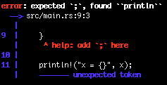
Control flow
This is how you ensure code runs under certain conditions
if, else if, else
Just like any other language
Remember that whatever you are conditioning on must result in a bool
If statements are expressions
This means they can be used within a let statement!

Slide 60
What happens if we put ; in the if expressions?

Slide 61
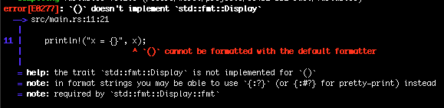
What happens if we put ; in the if expressions?

Slide 63
What about if we just put a ; on one of the branches?

Slide 64
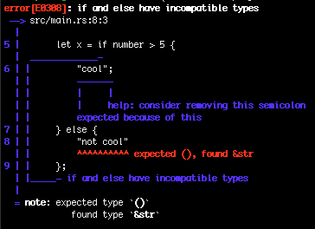

Slide 65
Type system catches it!

Slide 66
Loops
Loops used to repeat code
Same as any other language
loop
Loop until we break out
Break out with the break statement
While
Loop while some condition is true

Slide 67
Loops
Loops used to repeat code
Same as any other language
loop
Loop until we break out
Break out with the break statement
While
Loop while some condition is true
For
Loop through a collection

Slide 69
Any bugs?

Slide 70
Any bugs?
We are mutating i but we didn’t declare it as mutable (line 4)

Slide 71
Loops
Loops used to repeat code
Same as any other language
loop
Loop until we break out
Break out with the break statement
While
Loop while some condition is true
For
Loop through a collection

Slide 72
Loops
Loops used to repeat code
Same as any other language
loop
Loop until we break out
Break out with the break statement
While
Loop while some condition is true
For
Loop through a collection

Slide 73
Loops
The variable we will bind the value in the array to
Loops used to repeat code
Same as any other language
loop
Loop until we break out
Break out with the break statement
While
Loop while some condition is true
For
Loop through a collection

Slide 74
Loops
An Iterator
(more later)
Loops used to repeat code
Same as any other language
loop
Loop until we break out
Break out with the break statement
While
Loop while some condition is true
For
Loop through a collection

Slide 75
Loops
How might we use the for pattern to loop a certain number of times?
Loops used to repeat code
Same as any other language
loop
Loop until we break out
Break out with the break statement
While
Loop while some condition is true
For
Loop through a collection

Slide 76
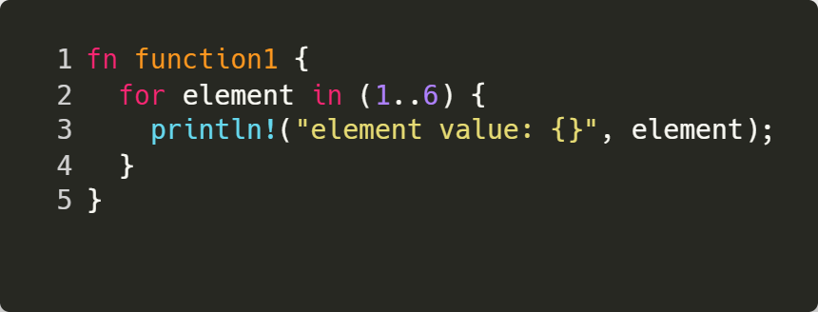
Loops
We can use a type called range
Loops used to repeat code
Same as any other language
loop
Loop until we break out
Break out with the break statement
While
Loop while some condition is true
For
Loop through a collection
Notes:
Check ranges in reverse order
Check mutability of the variable in a for statement

Slide 77
Loops
Parens shouldn’t be used here really.
My bad!
Loops used to repeat code
Same as any other language
loop
Loop until we break out
Break out with the break statement
While
Loop while some condition is true
For
Loop through a collection
Notes:
Check ranges in reverse order
Check mutability of the variable in a for statement

